Slide 1
SmartMed:
Smarter Care with RFID
ENGINEER 2PX3 - Communications & Social Impact (Winter 2025)
Group 96
Sammy Abbas (abbass50), Shiv Patel (pates302), Rushil Saha (sahar7), Luke Smith-Dwyer (smithdwl)
Date Submitted: April 1, 2025

Slide 2
Table of contents
1
3
2
4
Introduction
Context
Background
Solution

Slide 3
1
Introduction

Slide 4
The Mission
We are a team of engineering students focused on:
Creating practical solutions to everyday healthcare challenges
Improving current infrastructures to boost efficiency
Enhancing the quality of care for patients and hospital staff
Designing systems that bridge the gap between healthcare and technology
Driving innovation and real-world impact through learning

Slide 5





The Team
Shiv Patel
Rushil Saha
Sammy Abbas
Comp II
Tron II
Comp Mgmt II
Luke Smith-Dwyer
Ryan Wang
Civil II
Tron II

Slide 6
2
Background

Slide 7
Background
Hospitals face significant challenges in patient triage, tracking, and workflow efficiency, leading to delayed treatment, overcrowding, and inefficient resource allocation.
Current systems rely heavily on manual processes and fragmented data management, making real-time prioritization difficult and increasing the risk of human error.
Manual check-ins
Static prioritization
Paper record-keeping

Slide 8
3
Context

Slide 9
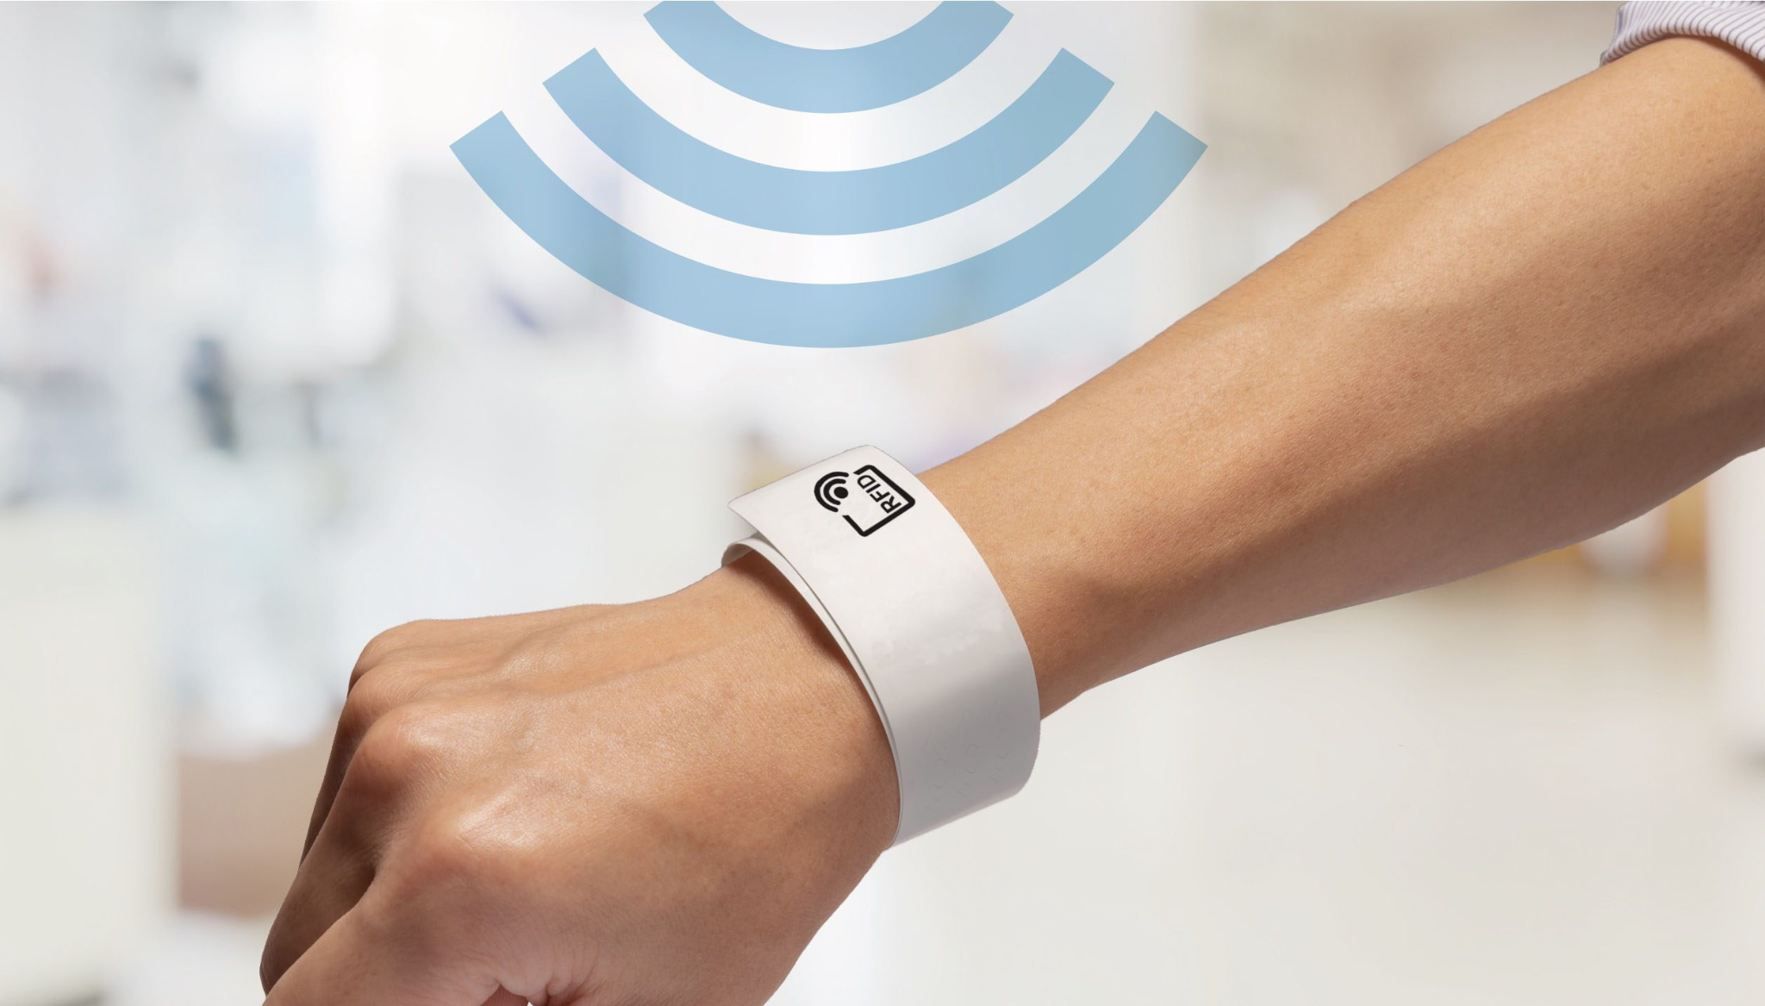

Context
Information Gathering & Distribution:
Ensures that critical patient information is accurate, up-to-date, and easily accessible by staff
Reduce operating cost by automating procedures & Using reusable RFID WristBands.
SmartMed WristBand
Radio-Frequency Identification
Notes:
In the current healthcare system, hospitals often face challenges in managing overcrowded waiting rooms and ensure critical patients receive timely care.The current method hospitals are utilizing rely heavily on manual check-ins, static prioritization, and paper record-keeping. This leads to critical patients experiencing treatment delays due to inefficient triage procedures, increasing medical staff workload leading to burnouts and extra operating cost, as well as lack of real-time data leading to suboptimal resource distribution. To address these issues, Our team hope to develop a SmartMed wristband by integrating RFID (radio-frequency identification) technology to reduce the wait times by efficiently tracking patient movement and injury prioritization.Our projects focuses on two key areas, we hope to reduce the operating cost by automating procedures and using reusable RFID wristbands, so hospitals can improve efficiency without adding additional labor. Secondly, the information gathered & distributed using our system, can be utilized to optimize hospital workflow and resource allocation. (WHO, will go more in detail regarding how exactly we will catoregize them by priorities, how we will track the patient’s movement, and how we wish to implement this feature in hospitals.)

Slide 10
4
Solution

Slide 11



Problems to Address
Inefficient Patient Tracking & Prioritization
Manual Systems
Manual processes make it difficult to accurately track patient status, leading to delays in care.
Relying on paper records and verbal updates increases human error and miscommunication.
Slow Triage
Increased Stress
Without an automated system, non-urgent patients may remain in the queue longer than necessary, adding to congestion.
Doctors and nurses must constantly juggle patient prioritization manually, adding pressure to an already high-stress environment.

Slide 12
Opportunities to Address
RFID technology can automate and streamline patient tracking
RFID-enabled wristbands provide real-time data on patient movement, reducing reliance on manual record-keeping.
Reducing human errors and improving treatment response time
Automated tracking ensures that critical patients receive timely care by minimizing miscommunication.
Dynamic patient queue updates ensure critical patients are prioritized
Real-time data allows staff to adjust patient priority levels based on changing conditions, improving triage efficiency.

Slide 13
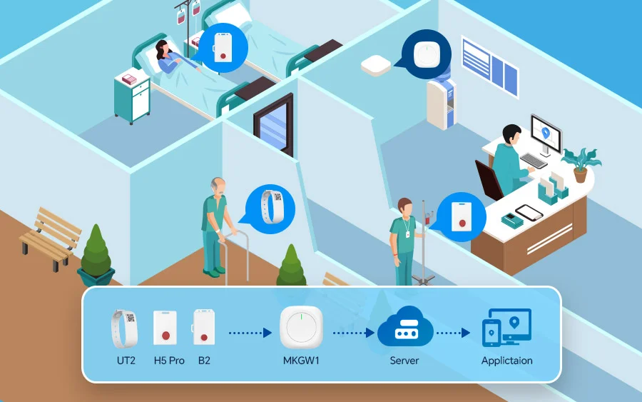
Prototype Overview
RFID-enabled wristband for patient tracking & prioritization.
Automated system to enhance triage efficiency.
Web-based dashboard for real-time patient status monitoring.
Notes:
https://www.mokosmart.com/how-to-streamline-healthcare-operations-patient-tracking/

Slide 14

Prototype Overview
Low-fidelity prototype of a potential dashboard for hospital staff
Link to prototype: https://shiv-sp.github.io/2px3sprint3/
Notes:
https://www.mokosmart.com/how-to-streamline-healthcare-operations-patient-tracking/

Slide 15



How It Works?
Check-in & Wristband Issuance:
Patients receive color-coded RFID wristbands based on priority.
Linked to medical records via RFID readers.
Real-Time Patient Flow Management:
RFID scanners track patient movement within hospital zones.
Alerts ensure no patient is overlooked.
Dynamic Queue Updates:
Staff can update priority based on worsening conditions.
Helps optimize doctor-patient distribution and hospital resources.
Notes:
Hardware:
RFID wristbands with unique patient IDs.
RFID scanners in check-in, waiting rooms, and doctor’s offices.
Software:
Web-based dashboard for monitoring wait times & patient data.
Database integration (MySQL or Firebase) for real-time updates.
Power Source:
Passive RFID wristbands require no battery, ensuring long-term usage.

Slide 16
Why SmartMed?
Tailored for Healthcare - Other RFID tech companies focus on asset management. Our system is built specifically for hospitals, addressing industry-specific challenges.
Limited Adoption in Canada - RFID in Canadian healthcare is underutilized [1]; we aim for widespread implementation in hospitals.
Data Security First - Tackles privacy concerns and compliance issues uniques to healthcare.
Scalable - Expands into a comprehensive hospital management ecosystem beyond patient tracking.

Slide 17
Navigating Constraints
Integration - Proven tech but faces privacy & data access hurdles in Canada [2] [3]. Needs API access & standardized health care to reach full potential.
Feasible Within Five Years - Phased rollout ensures quick implementation.
Security & Compliance - A core value of our project, using state-of-the-art encryption to protect patient data. RFID contains no private information.
Cost-Effectiveness - RFID tags cost as little as $0.20 to print [4]. The system aims to reduce admin workload and improve overall efficiency, leading to long-term savings

Slide 18
Achieving Goals
Our product seeks to improve hospitals struggling with patient information inefficiencies and to relieve the strain on doctors and nurses caused by burdening administrative workload.
SmartMed RFID achieves our goals by:
Being Cost-Effective - Low hardware and maintenance costs; reduces administrative labour expenses.
Improving Efficiency - Prevents bottlenecks by improving patient flow.
Reducing Staff Workload - Less time spent on admin tasks, more time for patient care.

Slide 19
Critical Path & Duration of Tasks
Phase 1: Planning & Research
Conduct research, feasibility studies, define the project scope, gather requirements, and meet with stakeholders
Phase 2: Design & Prototyping
Develop system architecture, and draft and finalize UI/UX
Phase 3: Development
Build the core system, integrate the key features, and develop the database
Phase 4: Testing & Integration
Perform system testing, security checks, and integrate all components
Phase 5: Deployment & Optimization
Launch the system for simulations, monitor performance and feedback, and refine for stability for final launch

Slide 20
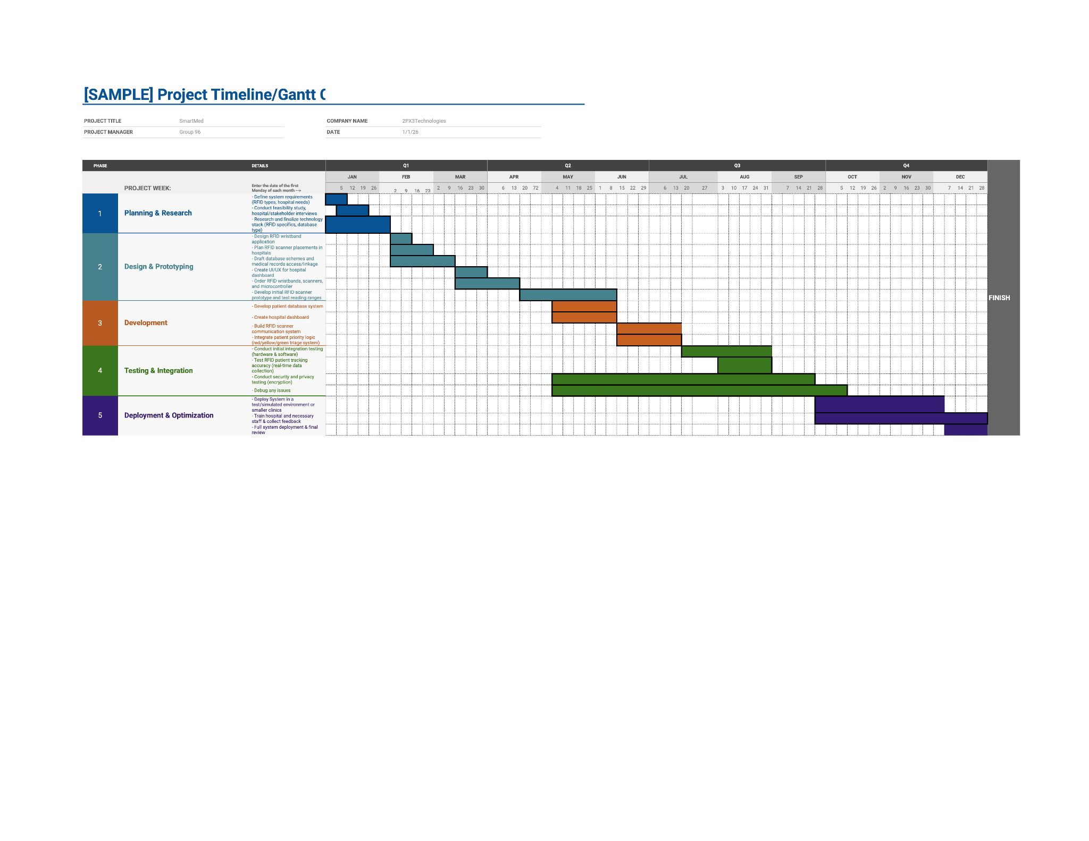
Critical Path & Duration of Tasks
Notes:
Hardware:
RFID wristbands with unique patient IDs.
RFID scanners in check-in, waiting rooms, and doctor’s offices.
Software:
Web-based dashboard for monitoring wait times & patient data.
Database integration (MySQL or Firebase) for real-time updates.
Power Source:
Passive RFID wristbands require no battery, ensuring long-term usage.

Slide 21
Thank you!

Slide 22
References
[1] Accessed: Apr. 01, 2025. [Online]. Available: https://www.impinj.com/library/customer-stories/north-york-general-hospital-improves-operatio
[2] “High-tech tracking heading for hospitals,” CBC News, Jan. 23, 2008. Accessed: Apr. 01, 2025. [Online]. Available: https://www.cbc.ca/news/science/high-tech-tracking-heading-for-hospitals-1.758413
[3] “Unlocking the power of health data,” Competition Bureau Canada. Accessed: Apr. 01, 2025. [Online]. Available: https://competition-bureau.canada.ca/en/unlocking-power-health-data
[4] “The Cost of An RFID System: An Estimated Budgeting Breakdown,” RMS Omega. Accessed: Apr. 01, 2025. [Online]. Available: https://rmsomega.com/the-cost-of-an-rfid-system/

